Slide 1
Enhanced Adaptive Watermarking System: EAWS
~An Approach to Preserve Identity
Presented by,
Aniket Bharti
Atul Singh
Karan Shah
Kshitij Chhajed

Slide 2
Aim
The novel system innovates Adaptive Watermarking techniques that assists in embedding encoded watermarks within images incorporating Least Significant Bit (LSB) methodology offering a highly secure, reliable, and robust system for watermarks.
Novelty:
Published Patent entitled “System and Methods for Protecting Digital Images” with Patent Application Number: 202021025628 [Under Examinations].

Slide 3
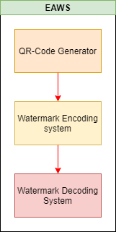
Work Flow & Objectives
Objectives
To Generate QR-Code from the watermark.
To resize the QR-Code generated to embed within Image.
To Computer size of base image and QR-Code.
To encode QR-Code using “NOT” operation.
To embed multiple encoded QR-Code using LSB technique within base image.
To decode watermarked image by extracting watermark from QR-Code.

Slide 4
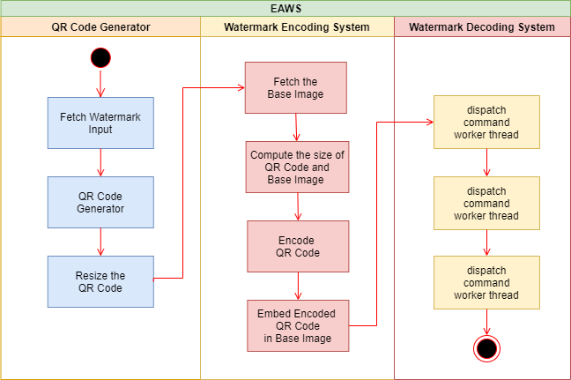
System Architecture

Slide 5




QR-Code Representation
E.g. Watermark Text: Hello World
QR-CODE :
QR-Code Representation
Pixel Format Representation
Encoded QR-Code Representation
Encoded Pixel Format QR Representation

Slide 6


Least Significant Bit Methodology
Pixel Representation for Mono chromatic Image
LSB
Pixel Representation for Colored chromatic Image
LSB
In Monochromatic Images we have only 1 LSB.
In Colored Images we have 3 LSB’s.

Slide 7




Embedding QR-Code in Base Image
Watermark Encoding Scheme:
Base Image
Embedding Process
Watermark Embedded Image
Embedded Pixel Format Base Image Representation

Slide 8

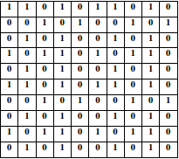
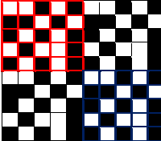

Extracting Multiple Watermark Instances within Images
Extracting Multiple Watermarks from Monochromatic Image:
Monochromatic Image
with watermark embedded
Embedding Process
Decoded Multiple Watermarks
Mapping the watermark
with Pixel Color

Slide 9

Detecting QR-Code and Decoding Watermark
Decoding the QR-Code to obtain the watermark:
Hello World
Encoded QR-Code

Slide 10
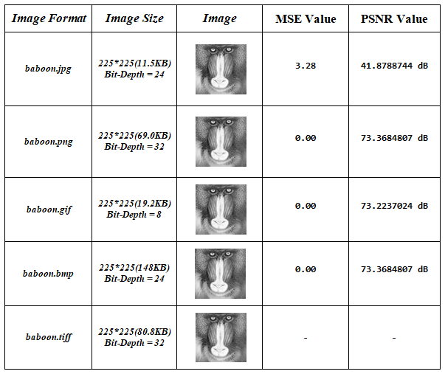
Experimental Results

Slide 11
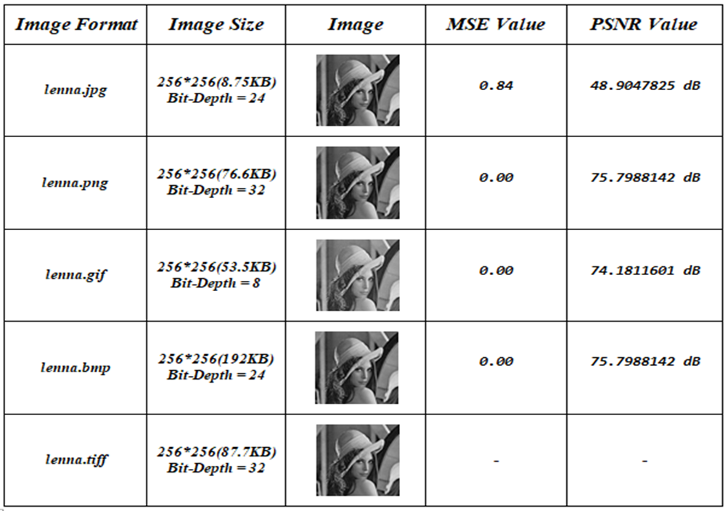
Experimental Results

Slide 12
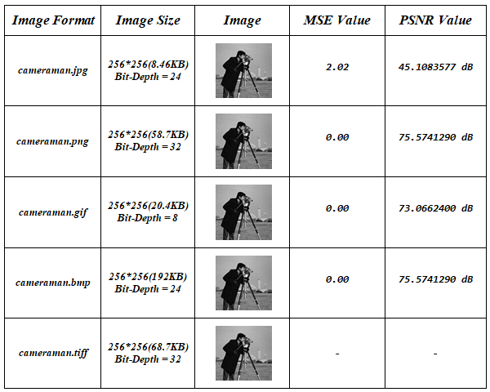
Experimental Results

Slide 13
Comparative Performance
Copyright Protection
Applicability for Image, Audio, Video files
Various image formats such as .jpg, .tiff, .png etc.
Content data protection

Slide 14
Conclusion
Protection Against
Scaling Attacks
Protection Against
Gaussian
Noise Attacks
Facilitates LSB method
of Steganography
Protection Against
Cropping Attacks
Reliable and Easier to use
Supports various format of images
Improved performance and Easy to maintain
Protection Against
Rotation Attacks
Provides Faster Results
Achieves higher PSNR and lower Mean Square Error value

Slide 15
Applications
Copyright Protection
Applicability for Image, Audio, Video files
Various image formats such as .jpg, .tiff, .png etc.
Content data protection

Slide 16
REFERENCES
[1] Phong Tuam Ngo and Hung Quang Ta, “An Improved Blind Watermarking Technique Against JPEG Compression Attack”, 2018 International Conference on Advanced Technologies for Communications.
[2] Neena Raj N. R. and Shreelekshmi R., “Blockwise Fragile Watermarking Schemes for Tamper
[3] Localization in Digital Images”, 2018 International CET Conference on Control, Communication, and Computing (IC4) | July 05-07, 2018 | Trivandrum.
[4] Naveen Kumar Yadav and S. Selvakumar, “An Optimized Transform Domain Watermarking Technique for Grayscale Images of Medical Applications”, 2018 3rd International Conference for Convergence in Technology (I2CT) The Gateway Hotel, XION Complex, Wakad Road, Pune, India. Apr 06-08, 2018.

Slide 17
REFERENCES
[5] Yuanfang Gua, Xiaochun Cao, Rui Wang and Cheng Jin, “A New Data Embedding Method with a New Data Embedding Domain for JPEF Images”, 2018 IEEE Fourth International Conference on Multimedia Big Data (BigMM).
[6] Salah Mokhnache, Tewfik Bekkouche and Djamel Chikouche, “A Robust Watermarking Scheme Based on DWT and DCT Using Image Gradient”, International Journal of Applied Engineering Research ISSN 0973-4562 Volume 13,Number 4 (2018) pp. 1900-1907.
[7] Xinchun Cui, Yuyibg Niu, Xiangwei Zheng and Yingshuai Han, “An optimized digital watermarking algorithm in wavelet domain based on differential evolution for color image”,PLOS ONE | https://doi.org/10.1371/journal.pone.0196306 May 21, 2018.
[8] Yongzhong Li, YiLi and Xuan Luo, “An Adaptive Blind Watermarking Algorithm Based on DCT and Its Application in Big Data”, 2018 Sixth International Conference on Advanced Cloud and Big Data.

Slide 18
REFERENCES
[8] Yongzhong Li, YiLi and Xuan Luo, “An Adaptive Blind Watermarking Algorithm Based on DCT and Its Application in Big Data”, 2018 Sixth International Conference on Advanced Cloud and Big Data.
[9] Deepa B. Maheshwari, “An Analysis of Wavelet Based Dual Digital Image Watermarking Using SVD”, 2018 International Conference On Advances in Communication and Computing Technology (ICACCI) Amrutvahini College of Engineering, Sangamner, Ahmednagar, India. Feb 8-9. 2018.
[10] Purnima Pal, Harsh Vikram Singh and Sarvesh Kumar Verma, “Study on Watermarking Techniques in Digital Images”, Proceedings of the 2nd International Confdrence on Trends in Electronic and Infomratics (ICOEI 2018) IEEE Conference Record: # 42666; IEEE Xplore ISBN: 978-1-5386-3570-4.
[11] Shailesh Sapkal and B. G. Hogade, "Colour-Adaptive Digital Image Watermarking Technique”

Slide 19
Thank You

